Slide 1
Regularization
Dr. Mehmet Yasin Ulukuş

Slide 2
Regularization
Shrinkage approach involves fitting a model involving all p predictors
However, the estimated coefficients are shrunken towards zero
This shrinkage (also known as regularization) has the effect of reducing variance
Depending on what type of shrinkage is performed, some of the coefficients may be estimated to be exactly zero
Hence, shrinkage methods can also perform variable selection
We will first give regularization theory in general context and provide two instances for linear regression (Ridge and Lasso)
Before starting regularization, let’s revisit overfitting

Slide 3
Overfitting
Consider a simple one-dimensional regression problem with five data points
The target function is a 2nd order polynomial
We added a little noise to create the data points.
We use 5 data points to fit a 4th order polynomial

Slide 4
Overfitting
Consider a simple one-dimensional regression problem with five data points
The target function is a 2nd order polynomial
We added a little noise to create the data points.
We use 5 data points to fit a 4th order polynomial
Though the target is simple, the learning algorithm used the full power of the 4th order polynomial to fit the data exactly, but the result does not look anything like the target function
The data has been overfit

Slide 5
Regularization
With regularization
The data has been overfit

Slide 6
Regularization
Though we only used a very small 'amount' of regularization, the fit improves dramatically
Regularization constrains the learning algorithm to improve out-of-sample error, especially when noise is present
Regularization is as much an art as it is a science
Most of the methods used successfully in practice are heuristic methods
Regularization attempts to minimize $E_{out}$ by working through the equation
$$E_{out}\left(h\right)≤E_{training}\left(h\right)+Ω(h)$$
Instead of minimizing $E_{training}(h)$ alone, one can minimize a combination of $E_{training}(h)$ and $Ω(h)$.
The proof of the above inequality is out of scope of our class, but you can think of it as out sample error is the sum of two errors: 1- Error in your fit 2- Generalization error.

Slide 7
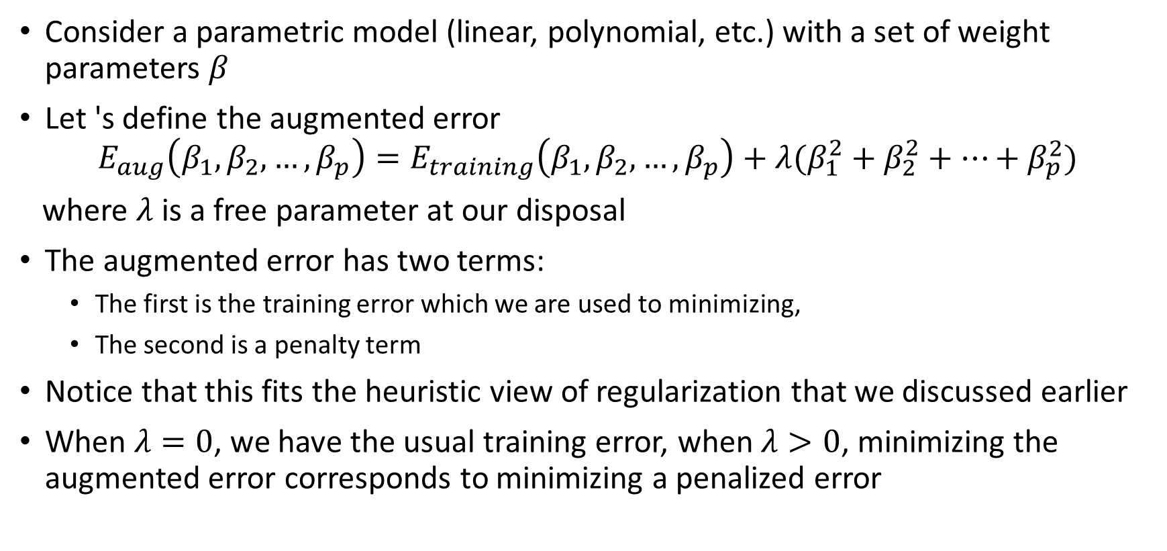
Weight Decay
Consider a parametric model (linear, polynomial, etc.) with a set of weight parameters $β$
Let 's define the augmented error
$$E_{aug}\left(β_{1},β_{2},…,β_{p}\right)=E_{training}\left(β_{1},β_{2},…,β_{p}\right)+λ(β_{1}^{2}+β_{2}^{2}+…+β_{p}^{2})$$
where $λ$ is a free parameter at our disposal
The augmented error has two terms:
The first is the training error which we are used to minimizing,
The second is a penalty term
Notice that this fits the heuristic view of regularization that we discussed earlier
When $λ=0$, we have the usual training error, when $λ>0$, minimizing the augmented error corresponds to minimizing a penalized error

Slide 8
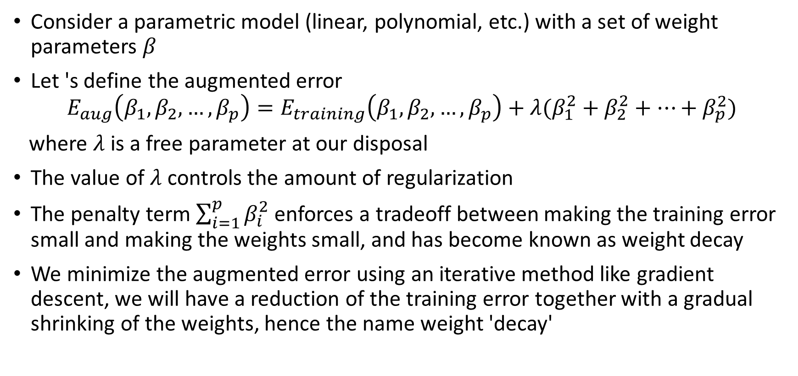
Weight Decay
Consider a parametric model (linear, polynomial, etc.) with a set of weight parameters $β$
Let 's define the augmented error
$$E_{aug}\left(β_{1},β_{2},…,β_{p}\right)=E_{training}\left(β_{1},β_{2},…,β_{p}\right)+λ(β_{1}^{2}+β_{2}^{2}+…+β_{p}^{2})$$
where $λ$ is a free parameter at our disposal
The value of $λ$ controls the amount of regularization
The penalty term $\sum_{i=1}^{p}{β_{i}^{2}}$ enforces a tradeoff between making the training error small and making the weights small, and has become known as weight decay
We minimize the augmented error using an iterative method like gradient descent, we will have a reduction of the training error together with a gradual shrinking of the weights, hence the name weight 'decay'

Slide 9
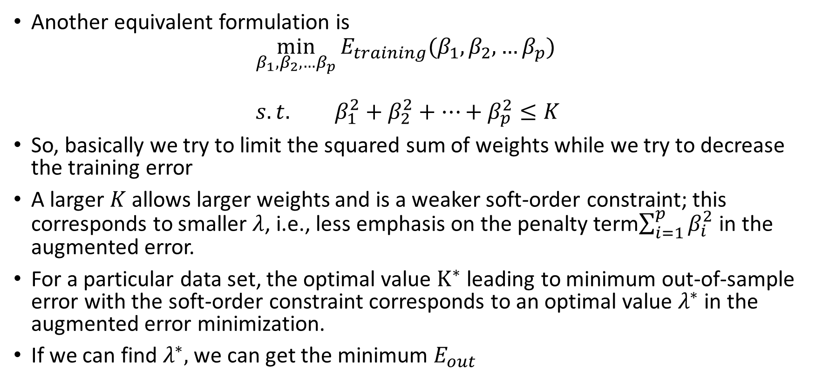
Weight Decay
Another equivalent formulation is
$$\min_{β_{1},β_{2},…β_{p}}{E_{training}(β_{1},β_{2},…β_{p})} \\ s.t. β_{1}^{2}+β_{2}^{2}+…+β_{p}^{2}≤K$$
So, basically we try to limit the squared sum of weights while we try to decrease the training error
A larger $K$ allows larger weights and is a weaker soft-order constraint; this corresponds to smaller $λ$, i.e., less emphasis on the penalty term$\sum_{i=1}^{p}{β_{i}^{2}}$ in the augmented error.
For a particular data set, the optimal value $K^{∗}$ leading to minimum out-of-sample error with the soft-order constraint corresponds to an optimal value $λ^{∗}$in the augmented error minimization.
If we can find $λ^{∗},$ we can get the minimum $E_{out}$

Slide 10
Ridge Regression
Ridge Regression is a weight decay method
Consider a linear regression model with p predictors
$$Y=β_{0}+β_{1}x_{1}+…β_{p}x_{p}$$
Recall that the least squares fitting procedure estimates $β_{0}, β_{1}, …, β_{p}$using the values that minimize
$$SSE=\sum_{i=1}^{n}{{\left(y_{i}−β_{0}−\sum_{j=1}^{p}{β_{j}x_{j}}\right)}^{2}}$$
In particular, the ridge regression coefficient estimates ${\hat{β}}^{R}$are the values that minimize
$$SSE+λ\sum_{i=1}^{p}{β_{i}^{2}}$$
Note that the shrinkage penalty is applied to $β_{1}, . . . , β_{p},$but not to the intercept $β_{0}$

Slide 11
Ridge Regression
In matrix form
$${\left(y−Xβ\right)}^{T}\left(y−Xβ\right)+λβ^{T}β$$
The ridge regression solutions is
$${\hat{β}}^{ridge}={\left(X^{T}X+λI\right)}^{−1}X^{T}y$$
Note that we estimate $β_{0}$ by
$$\overline{y}=\frac{1}{n}\sum_{i=1}^{n}{y_{i}}$$
The input matrix $X$ has $p$ (rather than $p + 1$) columns (unlike least square)

Slide 12
Ridge Regression
Error function has two terms and the tuning parameter $λ$ serves to control the relative impact of these two terms on the regression coefficient estimates
When $λ=0$, the penalty term has no effect, and ridge regression will produce the least squares estimates
However, as $λ→∞$, the impact of the shrinkage penalty grows, and the ridge regression coefficient estimates will approach zero
Unlike least squares, which generates only one set of coefficient estimates, ridge regression will produce a different set of coefficient estimates, ${\hat{β}}_{λ}^{R}$, for each value of $λ$
Selecting a good value for $λ$ is critical; where we will use cross-validation to obtain it

Slide 13
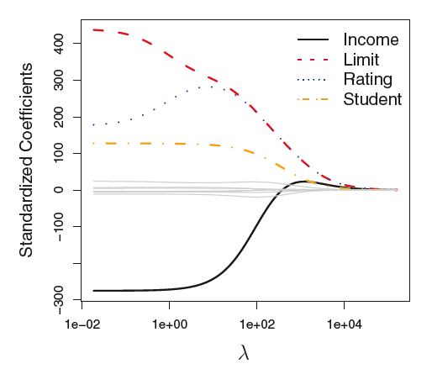
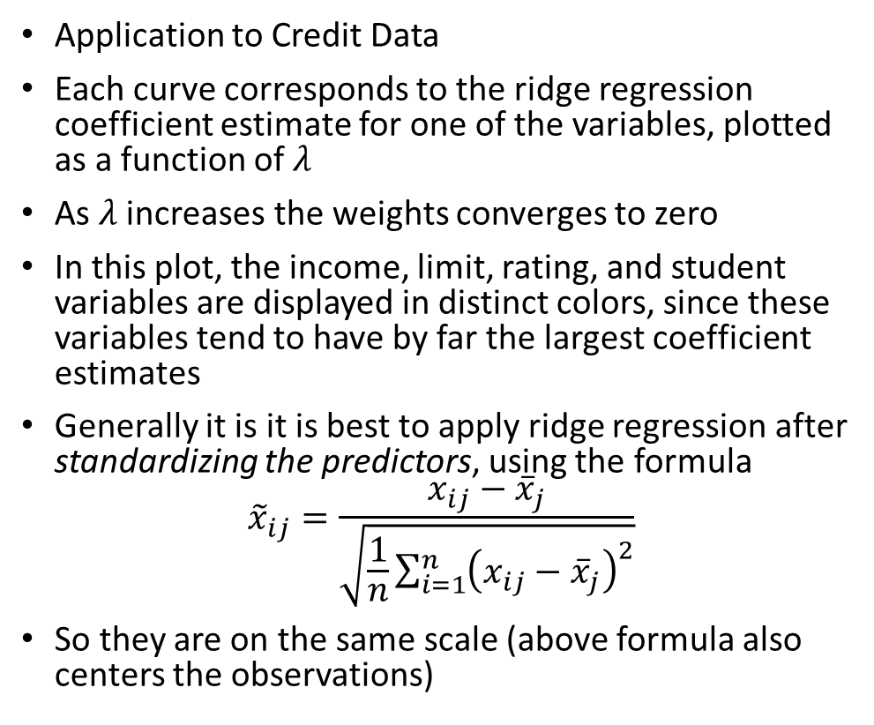
Ridge Regression
Application to Credit Data
Each curve corresponds to the ridge regression coefficient estimate for one of the variables, plotted as a function of $λ$
As $λ$ increases the weights converges to zero
In this plot, the income, limit, rating, and student variables are displayed in distinct colors, since these variables tend to have by far the largest coefficient estimates
Generally it is it is best to apply ridge regression after standardizing the predictors, using the formula
$${\tilde{x}}_{ij}=\frac{x_{ij}−{\overline{x}}_{j}}{\sqrt{\frac{1}{n}\sum_{i=1}^{n}{{\left(x_{ij}−{\overline{x}}_{j}\right)}^{2}}}}$$
So they are on the same scale (above formula also centers the observations)

Slide 14
Why does Ridge Regression Work?
Ridge regression’s advantage over least squares is rooted in the bias-variance trade-off
As λ increases, the flexibility of the ridge regression fit decreases, leading to decreased variance but increased bias
A lowered variance means that the model is less dependent on the sample, i.e., with a new sample we don’t get a very completely different model
The shrinkage of the ridge coefficient estimates leads to a substantial reduction in the variance of the predictions, at the expense of a slight increase in bias

Slide 15
Why does Ridge Regression Work?
Least Square
Target Function
Ridge

Slide 16
Why does Ridge Regression Work?
Least Square
Target Function
Ridge

Slide 17
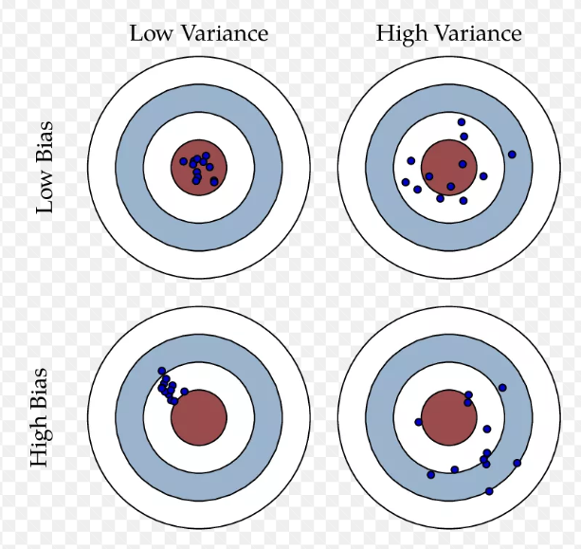
Why does Ridge Regression Work?
Least Square
Ridge

Slide 18
Why does Ridge Regression Work?
In general, in situations where the relationship between the response and the predictors is close to linear, the least squares estimates will have low bias but may have high variance.
This means that a small change in the training data can cause a large change in the least squares coefficient estimates.
In particular, when the number of variables $p$ is almost as large as the number of observations $n$, least squares estimates will be extremely variable.
And if $p>n$, then the least squares estimates do not even have a unique solution, whereas ridge regression can still perform well by trading off a small increase in bias for a large decrease in variance.
Hence, ridge regression works best in situations where the least squares estimates have high variance.

Slide 19
The Lasso
Ridge regression does have one obvious disadvantage
The penalty will shrink all of the coefficients towards zero, but it will not set any of them exactly to zero (unless $λ=∞$).
This may not be a problem for prediction accuracy, but it can create a challenge in model interpretation in settings in which the number of variables $p$ is quite large
For example, in the Credit data set, it appears that the most important variables are income, limit, rating, and student.
We might wish to build a model including just these predictors.
However, ridge regression will always generate a model involving all ten predictors
The lasso is a relatively recent alternative to ridge regression that overcomes this disadvantage

Slide 20
The Lasso
The lasso coefficients, ${\hat{β}}_{λ}^{L}$, minimize the quantity
$$SSE+λ\sum_{i=1}^{p}{{|β}_{i}|}$$
We see that the lasso and ridge regression have similar formulations with an only difference that the $β_{i}^{2}$ term in the ridge regression penalty has been replaced by ${|β}_{i}|$ in the lasso penalty
As with ridge regression, the lasso shrinks the coefficient estimates towards zero
However, in the case of the lasso, the penalty has the effect of forcing some of the coefficient estimates to be exactly equal to zero when the tuning parameter $λ$ is sufficiently large.
Hence, much like best subset selection, the lasso performs variable selection.

Slide 21
The Lasso
As a result, models generated from the lasso are generally much easier to interpret than those produced by ridge regression.
We say that the lasso yields sparse models—that is, sparse models that involve only a subset of the variables.
As in ridge regression, selecting a good value of $λ$ for the lasso is critical (can be done with cross-validation)
There is no closed form expression as in ridge regression
Computing the lasso solution is a quadratic programming problem

Slide 22
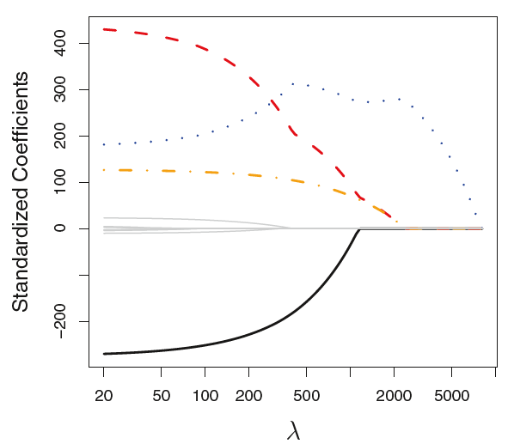
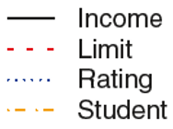
The Lasso
As an example, consider the Credit data set
When λ = 0, then the lasso simply gives the least squares fit, and when λ becomes sufficiently large, the lasso gives the null model in which all coefficient estimates equal zero
However, in between these two extremes, the ridge regression and lasso models are quite different from each other.
Moving from right to left , we observe that at first the lasso results in a model that contains only the rating predictor.
Then student and limit enter the model almost simultaneously, shortly followed by income.
Eventually, the remaining variables enter the model.

Slide 23
The Lasso
One can show that the lasso and ridge regression coefficient estimates solve the problems (equivalent formulation)
$$\min_{β}\left\{\sum_{i=1}^{n}{{\left(y_{i}−β_{0}−\sum_{j=1}^{p}{β_{j}x_{ij}}\right)}^{2}}\right\}$$ | subject to | $$\sum_{j=1}^{p}{\left|β_{j}\right|}≤K$$
and
$$\min_{β}\left\{\sum_{i=1}^{n}{{\left(y_{i}−β_{0}−\sum_{j=1}^{p}{β_{j}x_{ij}}\right)}^{2}}\right\}$$ | subject to | $$\sum_{j=1}^{p}{β_{j}^{2}}≤K$$

Slide 24
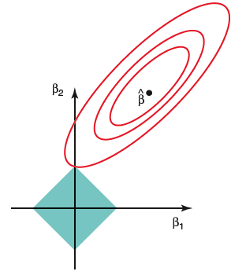
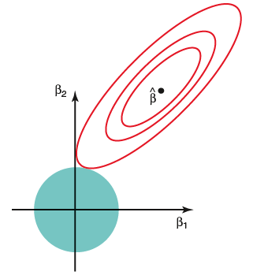
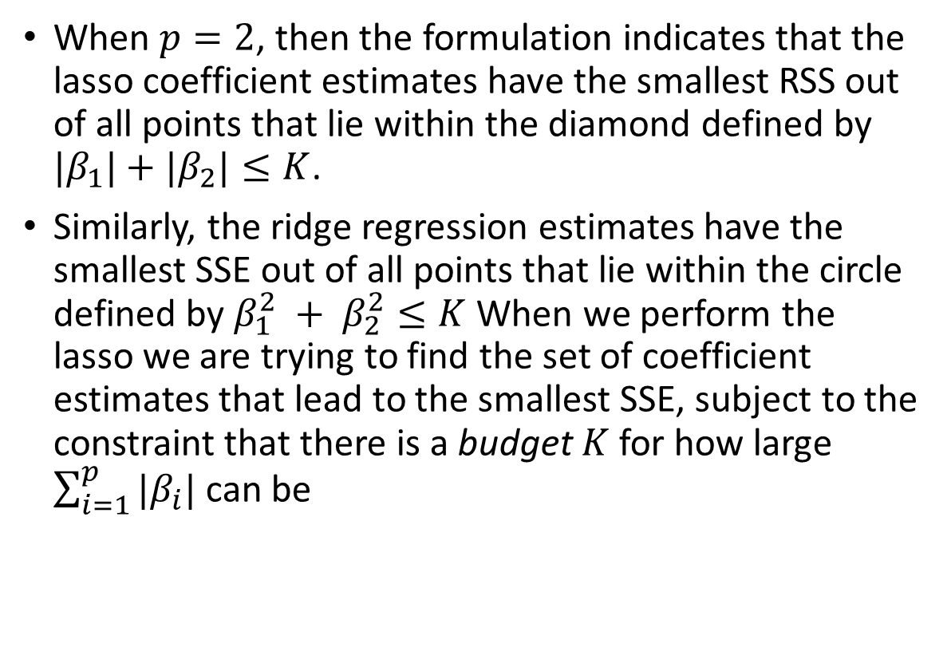
The Lasso
When $p=2$, then the formulation indicates that the lasso coefficient estimates have the smallest RSS out of all points that lie within the diamond defined by $|β_{1}|+|β_{2}|≤K$.
Similarly, the ridge regression estimates have the smallest SSE out of all points that lie within the circle defined by $β_{1}^{2} + β_{2}^{2}≤K$When we perform the lasso we are trying to find the set of coefficient estimates that lead to the smallest SSE, subject to the constraint that there is a budget $K$ for how large $\sum_{i=1}^{p}{{|β}_{i}|}$ can be

Slide 25
The Lasso
The ellipses that are centered around $\hat{β}$ represent regions of constant SSE
As the ellipses expand away from the least squares coefficient estimates, the SSE increases
The point where constraint set and contours intersect gives the minimum value of the constrained opt. problem
When K is extremely large, then the budget is not very restrictive, and so the coefficient estimates can be large.
In fact, if K is large enough that the least squares solution falls within the budget, then will simply yield the least squares solution

Slide 26
Variable Selection Property of The Lasso
Why is it that the lasso, unlike ridge regression, results in coefficient estimates that are exactly equal to zero?
Since ridge regression has a circular constraint with no sharp points, this intersection will not generally occur on an axis, and so the ridge regression coefficient estimates will be exclusively non-zero
However, the lasso constraint has corners at each of the axes, and so the ellipse will often intersect the constraint region at an axis. When this occurs, one of the coefficients will equal zero.

Slide 27
Comparison of Lasso and Ridge
It is clear that the lasso produces simpler and more interpretable models that involve only a subset of the predictors
However, the variance of ridge regression is slightly lower than the variance of the lasso
In general, one might expect the lasso to perform better in a setting where a relatively small number of predictors have substantial coefficients, and the remaining predictors have coefficients that are very small or that equal zero
Ridge regression will perform better when the response is a function of many predictors, all with coefficients of roughly equal size
However, the number of predictors that is related to the response is never known a priori for real data sets
Cross-validation can be used in order to determine which approach is better on a particular data set

Slide 28
Regularized Logistic Regression
For classification, regularization method is pretty similar
Recall that we maximize the log-likelihood to determine the weights of the logistic regression model
$$ℓ\left(β\right)=\sum_{i=1}^{N}{\left\{y_{i}\log{p\left(x_{i};β\right)}+\left(1−y_{i}\right)log⁡(1−p(x_{i};β))\right\}} \\ =\sum_{i=1}^{N}{\left\{y_{i}{{(β}_{0}+β}^{T}x_{i})−log(1+e^{β_{0}+β^{T}x_{i}})\right\}}$$
For regularized logistic regression, we would maximize a penalized log-likelihood function
$$\max_{β_{0},β}\left\{\sum_{i=1}^{N}{\left[y_{i}{{(β}_{0}+β}^{T}x_{i})−log(1+e^{β_{0}+β^{T}x_{i}})⁡\right]}−λ\sum_{j=1}^{p}{\left|β_{j}\right|}\right\}$$
As with the lasso, we typically do not penalize the intercept term, and standardize the predictors for the penalty to be meaningful.

Slide 29
Selecting parameter $λ$
Recall that every different $λ$ corresponds to a different model
So, selecting $λ$ is a model selection problem
Cross-validation provides a simple way to tackle this problem
We choose a grid of $λ$ values, and compute the cross-validation error for each value of $λ$
We then select the tuning parameter value for which the cross-validation error is smallest
Then we need to fit the model with the selected parameter $λ$ to evaluate the performance in the test set.

